Slide 1

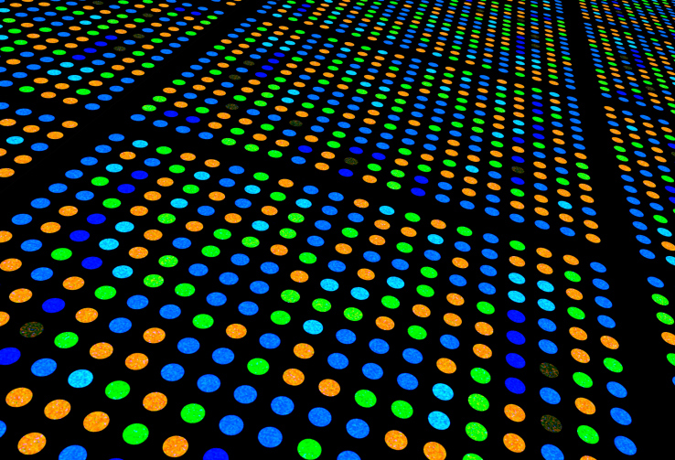
Transcriptomics : Microarrays and RNASeq
https://bi-ctsicn.github.io/CBU/
bioinformatics@childrensnational.org

Slide 2
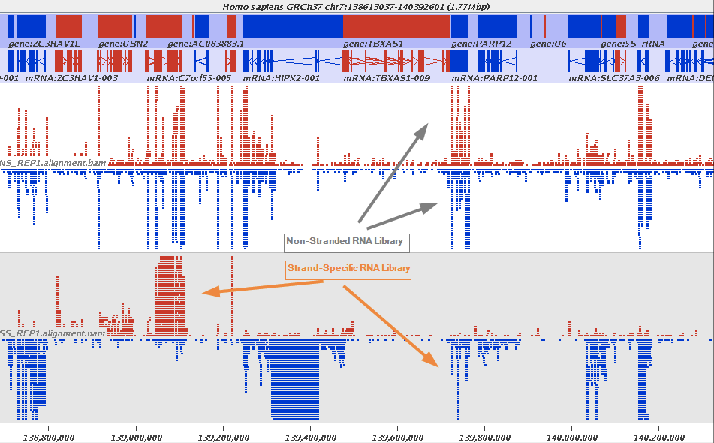

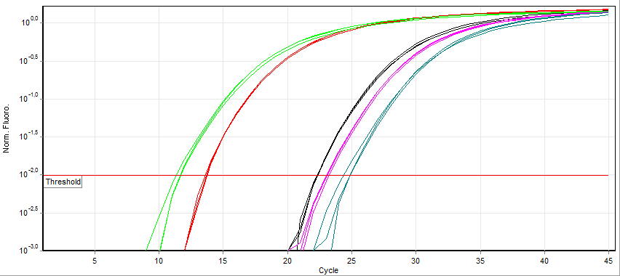
Transcriptomics: What and How?
T
A
C
A
A
A
A
T
G
T
T
T
RNASeq
Transcription
https://galaxyproject.org/tutorials/rb_rnaseq/
A
U
G
U
U
U
Microarray
Codon
Codon
Translation
Met
Phe
Quantitative PCR
Central Dogma

Slide 3
Transcriptomics: What and How?
T
A
C
A
A
A
A
T
G
T
T
T
Whole Transciptome
Transcription
https://galaxyproject.org/tutorials/rb_rnaseq/
A
U
G
U
U
U
Targeted
Codon
Codon
Translation
Met
Phe
Targeted
Central Dogma

Slide 4
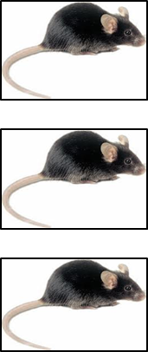
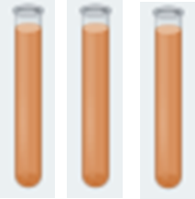
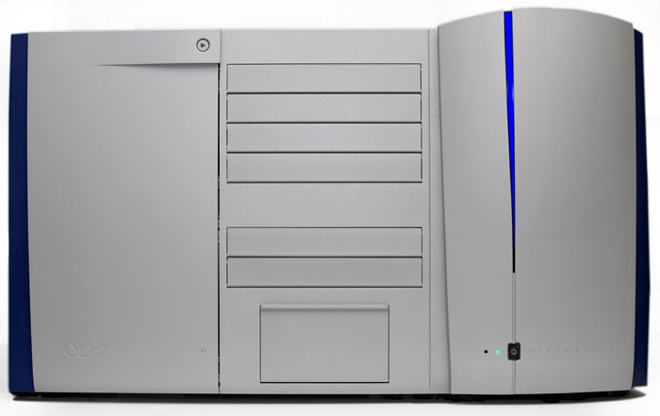
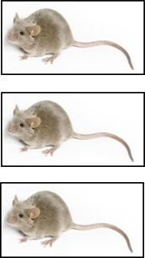
Workflow of a microarray experiments
Control
Control RNA
Samples
Experiment
Experimental
RNA Samples
Affymetrix microarray platform

Slide 5
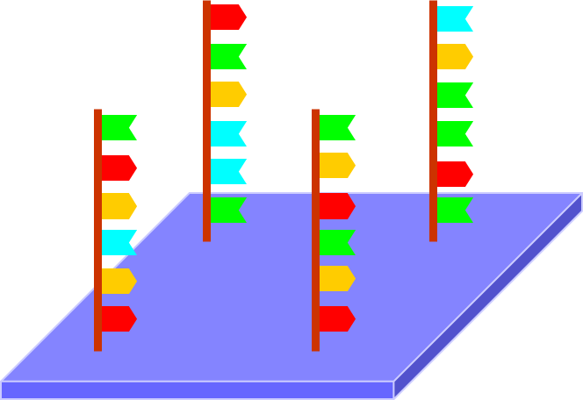
Workflow of a microarray experiments
Control
Control RNA
Samples
Experiment
Experimental
RNA Samples
https://brb.nci.nih.gov/techreport/ExpressionProfiling.ppt
Microarray Probes

Slide 6


Workflow of a microarray experiments
Control
Control RNA
Samples
Experiment
Experimental
RNA Samples
https://brb.nci.nih.gov/techreport/ExpressionProfiling.ppt
Microarray Probes

Slide 7

Workflow of a microarray experiments
Control
Control RNA
Samples
Experiment
Experimental
RNA Samples
https://brb.nci.nih.gov/techreport/ExpressionProfiling.ppt
Microarray Probes

Slide 8

Workflow of a microarray experiments
Control
Control RNA
Samples
Experiment
Experimental
RNA Samples
Microarray Plates

Slide 9
Workflow of a RNAseq experiments
Control
Control RNA
Samples
Experiment
Control RNA
Samples
Illumina Nextseq

Slide 10
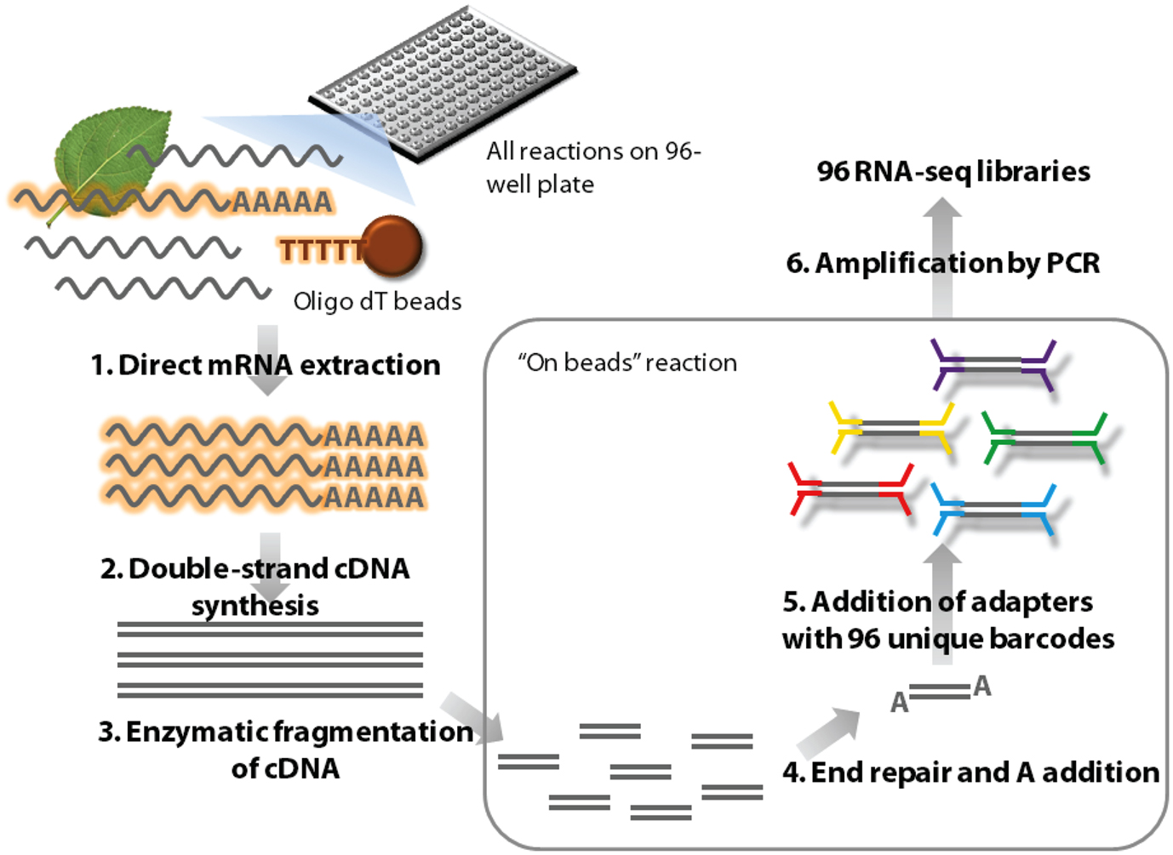
Workflow of a RNAseq experiments
Control
Control RNA
Samples
Experiment
Control RNA
Samples
https://www.frontiersin.org/articles/10.3389/fpls.2012.00202/full
Library preparation Pipeline

Slide 11
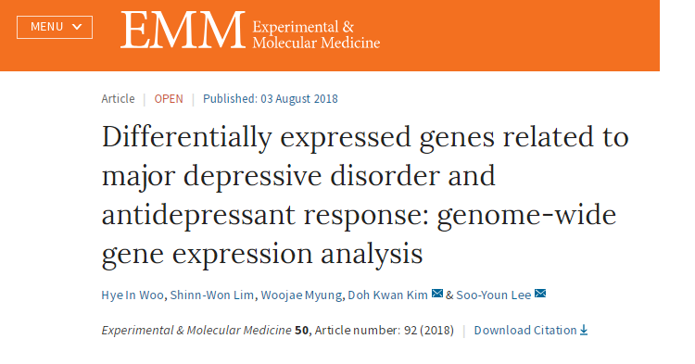
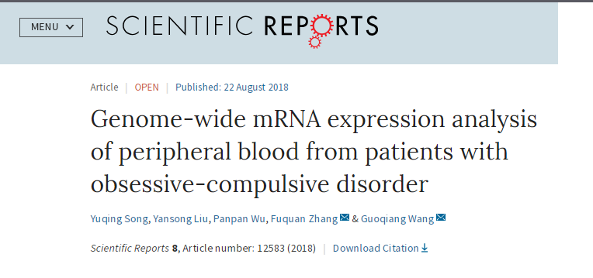

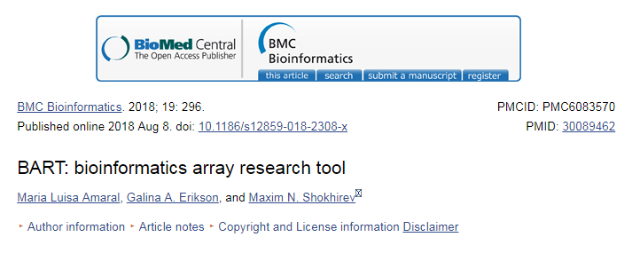
Is Microarray Dead?
Not Yet!!

Slide 12
Microarray
RNAseq
Organism well annotatated.
Organism does not need to be well annotated
Less cost per sample. Cost depends on number of probes used
Higher cost per sample. Cost depends on depth of sequencing.
Evaluates expression of known genes.
Evaluates expression of known as well as unknown gene.
Relative abundance
Absolute abundance
Analysis fast. Finishes in hours
Analysis slow. Takes days
High error and background noise, due to issues with hybridization.
Low error and background noise.

Slide 13
Life cycle of a Genomic Experiment
Design the experiment
Perform the experiment
Analyze the Data
What is the ultimate goal of the experiment?
Has this study been done before?
Is the organism well annotated?
Number of replicates/samples?

Slide 14
Life cycle of a Genomic Experiment
Design the experiment
Perform the experiment
Analyze the Data
Extraction of DNA sample depends upon the tissue/cell used. What kit to use?
How is the quality of the RNA?
What is the quantity of the RNA?

Slide 15
Life cycle of a Genomic Experiment
Design the experiment
Perform the experiment
Analyze the Data
Is this a novel experiment?
If not is there available literature for the pathway analyzed.
If novel is it on a known tissue/ cell type.
What platform used

Slide 16
Design of an Experiment
Design of the experiment
Discovery of novel transcript and Gene Expression
Use RNAseq
Goal of the experiment
Expression of genes
No
Use RNAseq
Organism well annotated
Yes
Check public repositories like Gene Expression omnibus (GEO) and arrayexpress for data
Proceed with the experiment
Yes
No
Has the study been done before?

Slide 17
Power of an Experiment
More sample=More accuracy of experiment.
Power of a binary hypothesis test is the probability that the test rejects the null hypothesis (H0) when a specific alternative hypothesis (H1) is true.
Statistical power ranges from 0 to 1, and as statistical power increases, the probability of making a type II error (wrongly failing to reject the null) decrease
Parameters to determine Power are:
I) mean number of false positive
II) The anticipated number of undifferentially expressed genes in the experiment
III) The specified power level for an individual gene, which represents the expected proportion of differentially expressed genes that will be declared as such by the tests
IV) Mean difference in log-expression between treatment and control conditions as postulated under the alternative hypothesis H1.
V) The anticipated standard deviation of the difference in log-expression between treatment and control conditions
https://sph.umd.edu/department/epib/sample-size-calculation-completely-randomized-treatment-control-designs

Slide 18
Replicates – why?
Ideally, if the experiment were repeated with new, independently obtained samples, the effect would likely be observed again.
Variation in data – are they actual biological changes or are just caused by chance?
Replication for Reproducibility!
Without replicates, what do you miss?
Identification of random Variation
Accuracy of measurement
Notes:
https://www.illumina.com/Documents/products/technotes/technote_power_replicates.pdf

Slide 19
Replicates
Biological replicates measure a quantity from difference sources under the same conditions
e.g., Tumors from 5 different people with lung cancer may show similar gene expression patterns. These replicates are useful to show what is similar in your replicates and how they are different from a different set of conditions (ie. treated, normal).
Technical replicates measure quantity from 1 source. This measures the reproducibility of the results. The differences are based only on technical issues in the measurement.
e.g., sequence the same sample twice but get different results
Notes:
https://www.biostars.org/p/103122/

Slide 20
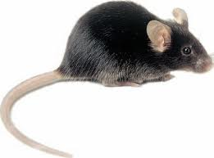
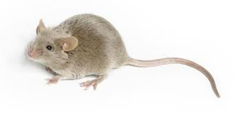
Replicates
S1
S2
S3
S4
S5
S6
Technical replicates are: S1 /S2 and S5 / S6
Biological replicates are: S3 – S1/S2 and S4 - S5/S6
To make inferences about the population you need biological replicates

Slide 21
Microarray Experiment (Wet Lab) (Susan/Karuna)
Sample Amount
Quality of Samples
Kits Required
Microarray platforms available on-site and at Georgetown
Cost
Any other things

Slide 22
Genomic Experiment (Data Analysis)
Provide the analyst with a list of gene
No
Is the experiment novel?
Yes
Provide the analyst with a list of gene
No
Is a new pathway being analyzed?
Yes
Proceed with the experiment

Slide 23
Files and Information Required for analysis microarray
Design of the experiment
Number of samples used?
Does your question require biological or technical replicates?
What kind of probes needed to answer your question?
Files and Information Required
Raw intensity files: If done in-house, the .CEL files from Affymetrix platform. If done elsewhere and done on other platforms, the platform name and raw data from the same.
Sample Names: Names associated to each sample.
Condition: Condition associated to each sample.

Slide 24
Microarray Analysis Pipeline
Extraction
affy
Extraction
Quality Check
Background Correction
Differential Gene Expression
Basic R
Quality Check
Background
Correction
affy
Affy (RMA)
Normalization
Differential Gene Expression
Limma

Slide 25
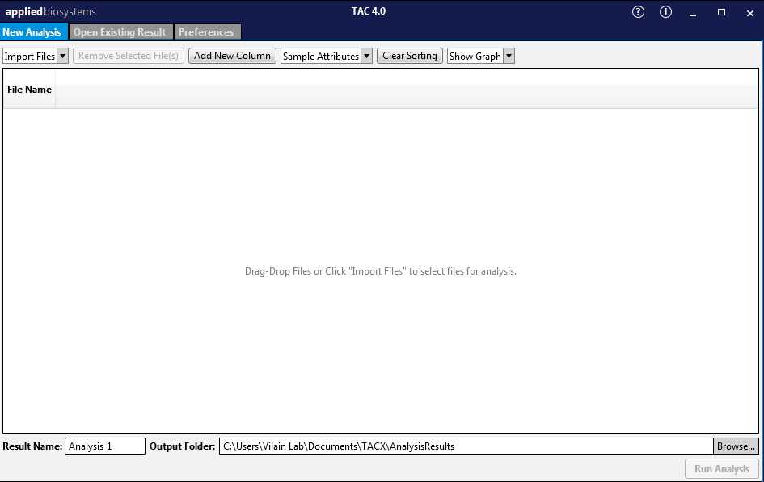
Introduction to TACC

Slide 26
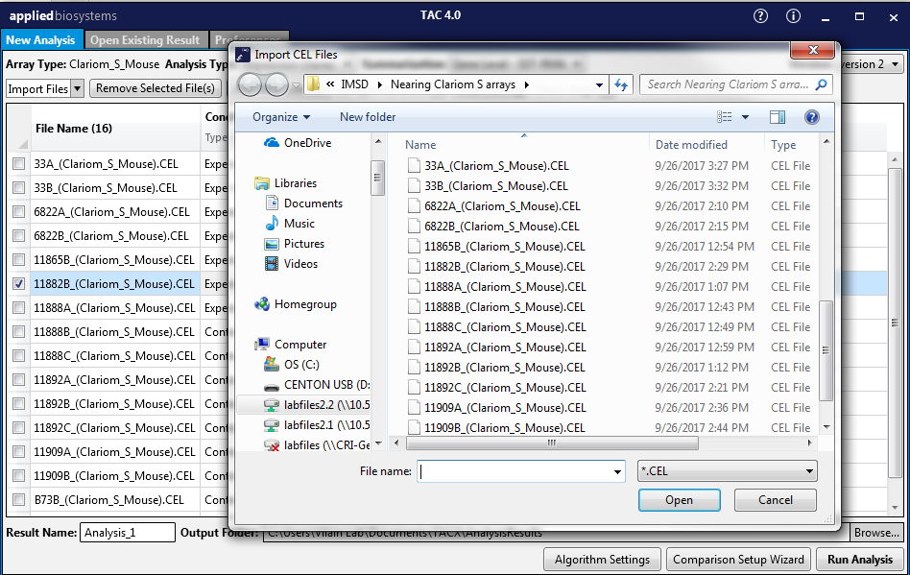
Importing CEL Files

Slide 27
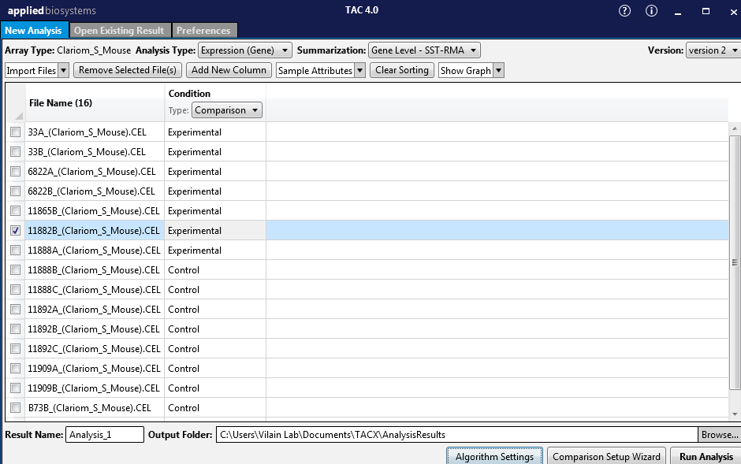
Apply Condition

Slide 28
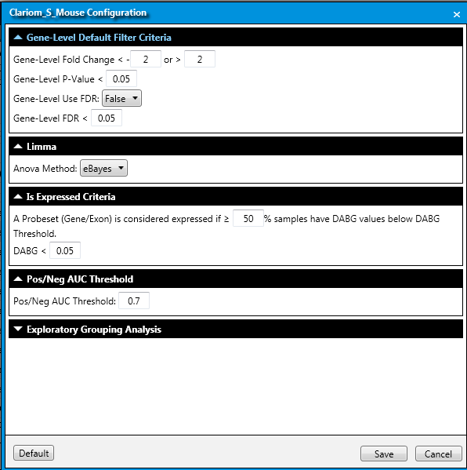
Selecting Statistical Methods

Slide 29
Files and Information Required for analysis RNAseq
Design of the experiment
Number of samples used?
Does your question require biological or technical replicates?
What is the coverage required for ?
Files and Information Required
Raw Read files: The output from the sequencers Fastq is needed. If done in other facility, fastq (or bam) has to be provided to the analysts, along with information about the sequencers, spike ins used, library type,etc.
Sample Names: Names associated to each sample.
Condition: Condition associated to each sample.

Slide 30
Read Length
Read length refers to the number of base pairs that are read at a time.
For a read length of 50 base pairs, single end reads would read 50 base pairs from each fragment,
while paired end reads would consist of 2 x 50bp reads, covering up to 100 base pairs on the same fragment.
While longer read lengths give you more accurate information on the relative positions of your bases in a genome, they are more expensive than shorter ones.
Notes:
Library prep
Tophat
Coverage

Slide 31
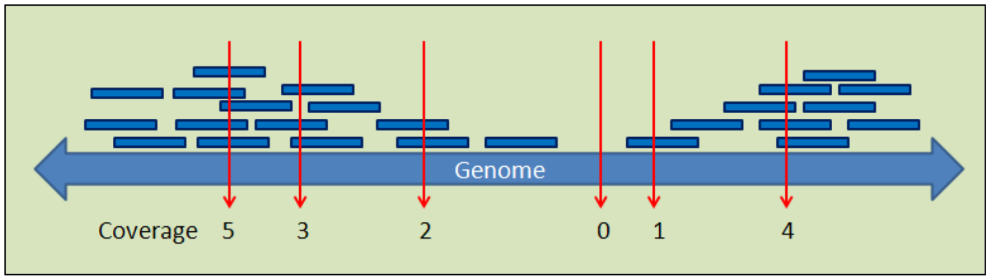
Coverage
Coverage refers to the average number of times a single base is read during a sequencing run.
Eg: If the coverage is 100 X, this means that on average each base was sequenced 100 times.
The more frequently a base is sequenced, the more reliable a base is called, resulting in better quality of your data.
Notes:
A sequencing run generates reads that sample a genome randomly and independently. These reads are not distributed equally across an entire genome; some bases are covered by fewer reads, some by more reads than the average coverage.
https://www.h3abionet.org/component/attachments/download/286

Slide 32
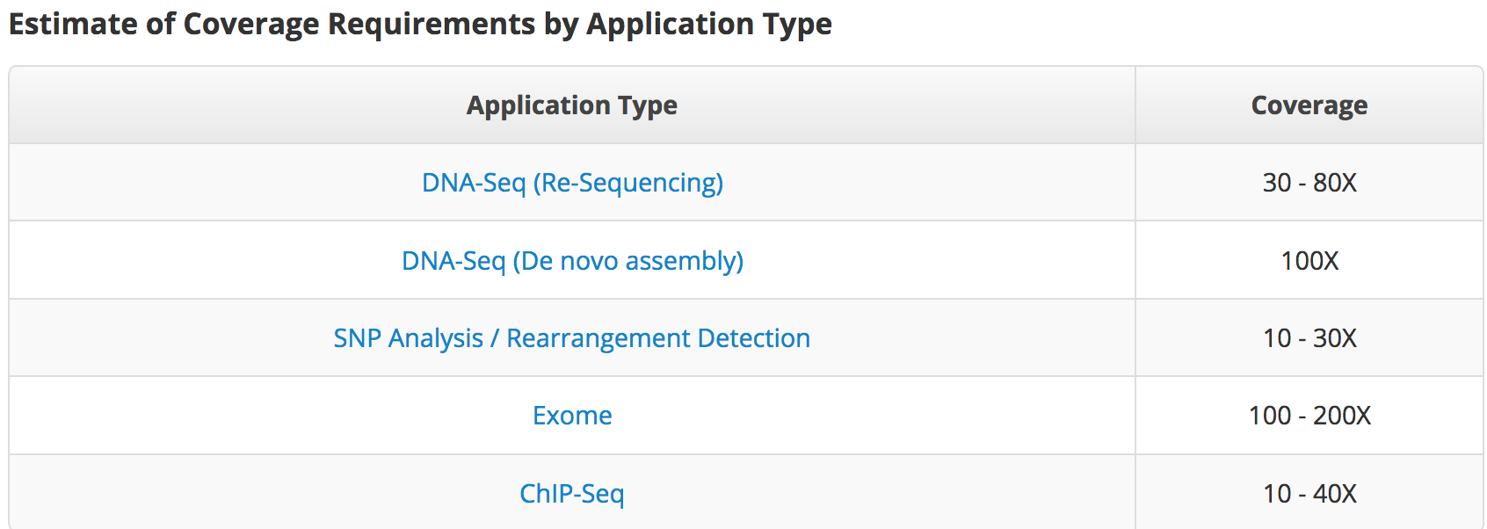
Coverage (DNA)
Notes:
https://genohub.com/next-generation-sequencing-guide/#depth

Slide 33
Coverage
Lander / Waterman equation
L (read length) * N (number of reads)
G (genome length)
Coverage (X) =
Coverage Calculators
http://core-genomics.blogspot.com/2016/05/how-many-reads-to-sequence-genome.html
http://apps.bioconnector.virginia.edu/covcalc/

Slide 34
Coverage (RNA)
A more useful metric for RNA-Seq is determining the total number of mapped reads.
It is important to distinguish between total reads and mapped reads, as not all reads will map onto a reference genome
So, the number of usable reads will be less than the number of actual reads.
The number of reads that will map depend on the
library type
quality of sample
how complete the reference genome is
Notes:
https://genohub.com/next-generation-sequencing-guide/#depth

Slide 35
Coverage (RNA)
Coverage needed for a RNA is not always uniform:
Different transcripts are expressed at different levels, meaning more reads will be captured from highly expressed genes while fewer reads will be captured by genes expressed at low levels
Alternate expression

Slide 36
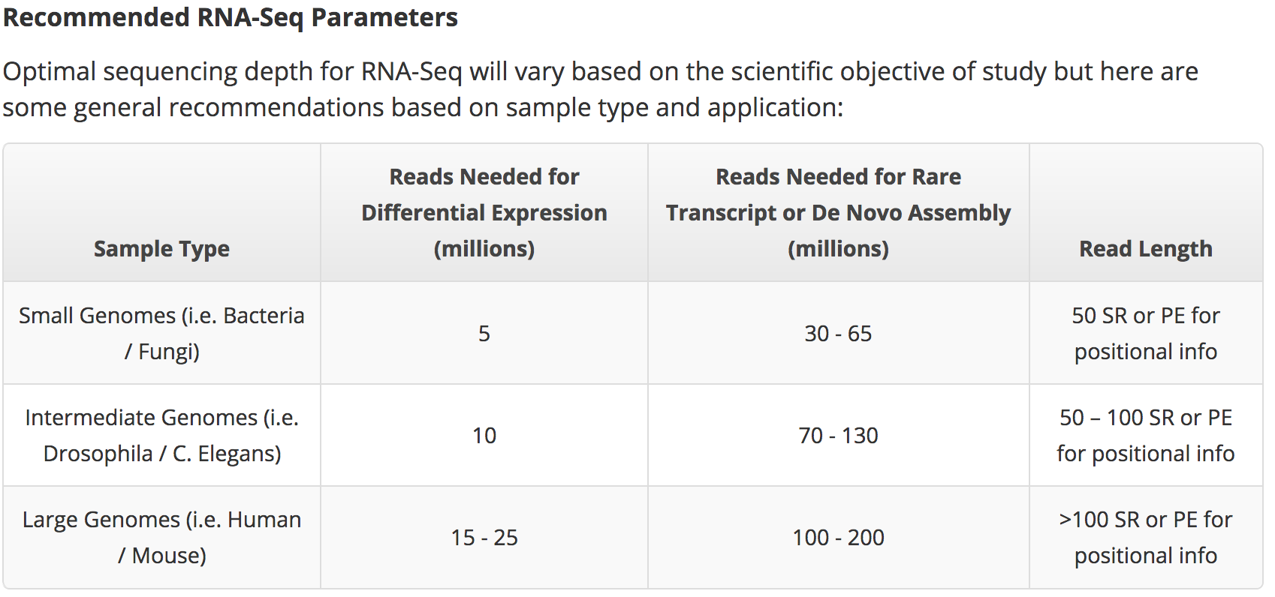
Coverage (RNA)
Notes:
https://genohub.com/next-generation-sequencing-guide/#depth

Slide 37
Sample and Library Preparation
Single end vs Paired end
PolyA vs Ribodepletion

Slide 38
Single end and Paired end
The sequencer instrument read from one end to the other end, and then start another round of reading from the opposite end.
The sequencer reads from one end of a fragment to the other end.
PE = paired end
(mate pairs)
SE = single end
PE sequencing provides additional positioning information in the genome

Slide 39
PolyA or RiboDepletion? (RNA)
Ribosomal RNA (rRNA) constitutes >70% of the purified total cell RNA.
RiboDepletion removes specifically ribosomal RNA, leaving all other RNA transcripts, however it is not 100% efficient.
PolyA selection is very efficient, but it will only select polyadenylated RNA, therefore many long, non coding RNAs will be lost.
Poly A | Ribo-depletion
Eukaryotes mostly | Prokaryotes
mRNA | mRNA along with non-coding RNA like lncRNA etc
3 prime bias | -

Slide 40
RNA-Seq Analysis Pipeline
Quality Check
FastQC
Quality check
Alignments
Data Pre-processing
Reads Counts
Differential Gene Expression
STAR/RSEM (2)
Alignment
Data preprocessing
Samtools/RSEM (1)
RSEM
Reads count
Deseq2
Differential Gene Expression

Slide 41
Fastq Format
FASTQ format is a
Text-based format
Stores :
Biological sequence
Corresponding quality scores
Size of fastq files depend on:
Type of experiment – WGS > Exome > RNA
Type of Genome – Human > Mouse > Bacteria
Coverage – more the coverage greater the size of fastq file

Slide 42
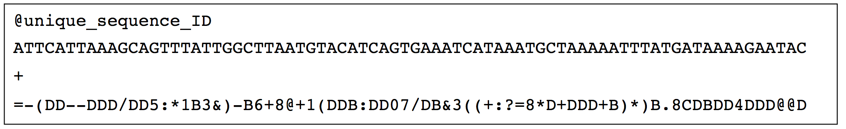
FASTA Format
FASTQ Format
sequence identifier and an optional description
raw sequence letters
quality values for the sequence

Slide 43
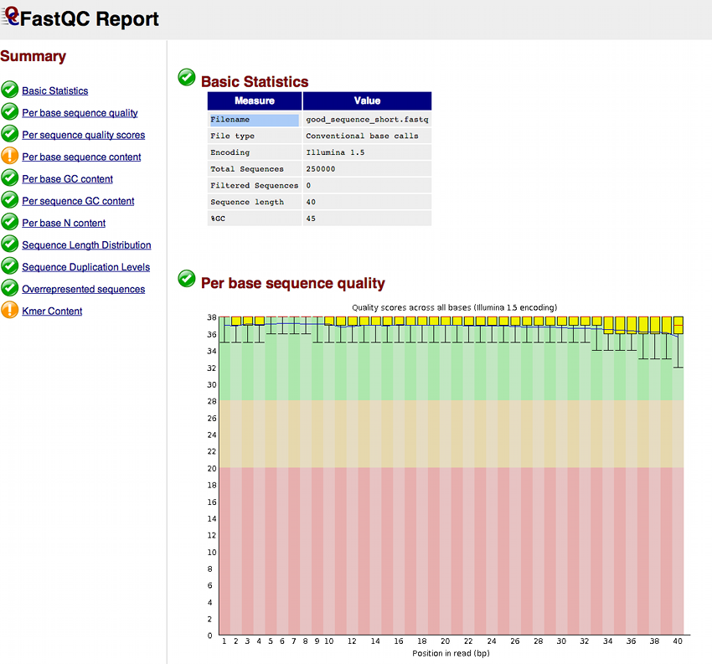
Quality Check
Tool: FastQC
Input: FastQ files
Output: HTML file

Slide 44
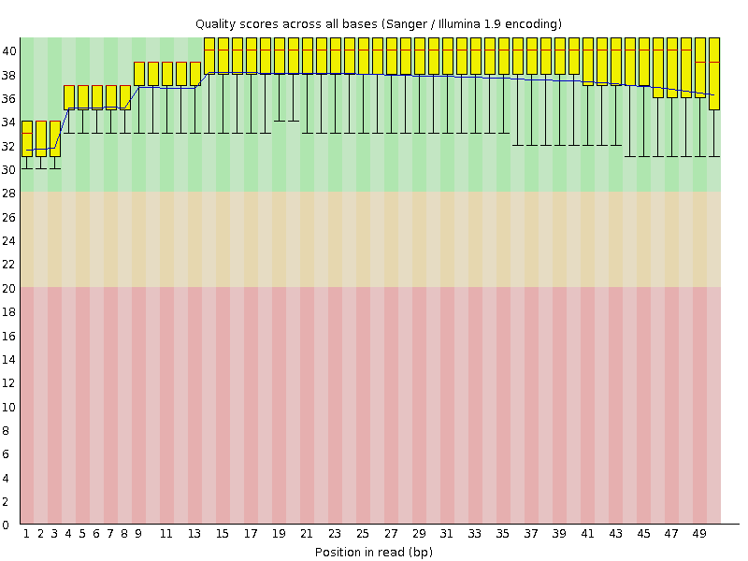
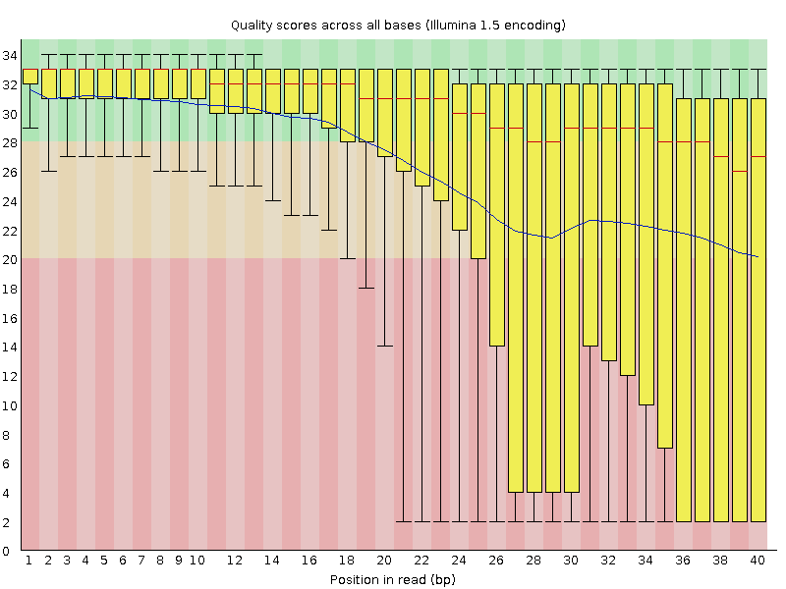
FastQC : Good vs Bad
Good Quality
Bad Quality

Slide 45
Alignments and Reads count
Tools : STAR and RSEM(2)
Input: RNA Seq. Reads (.fastQ) & Indexes (previous step output)
Output: .BAM/.SAM files
RNA Seq. Reads
Indexed Genome
STAR
Aligned Reads (BAM/SAM)
RSEM (2)
Alignment (.BAM/.SAM)
Gene Counts (.CSV)
Isoform Counts (.CSV)

Slide 46
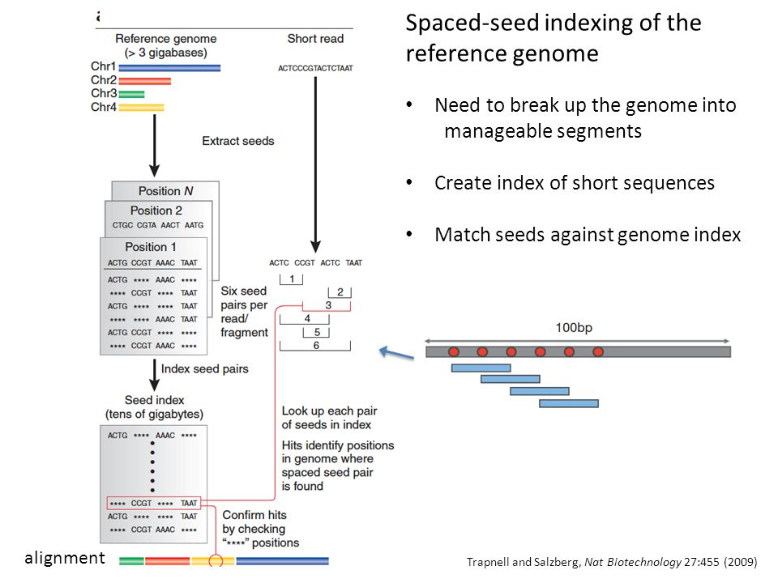
Indexing genome

Slide 47
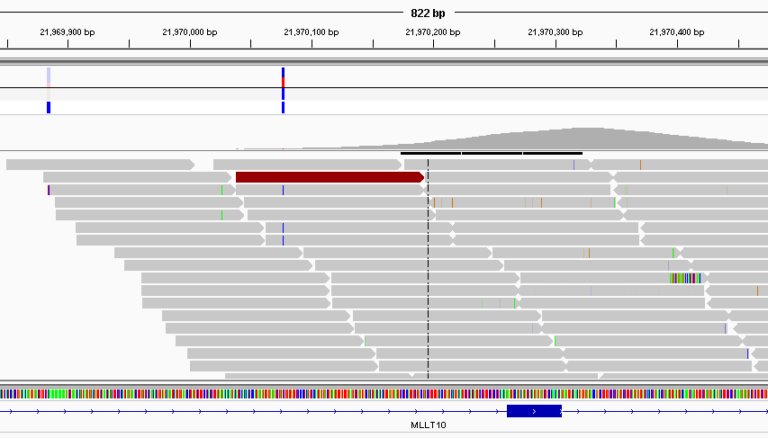
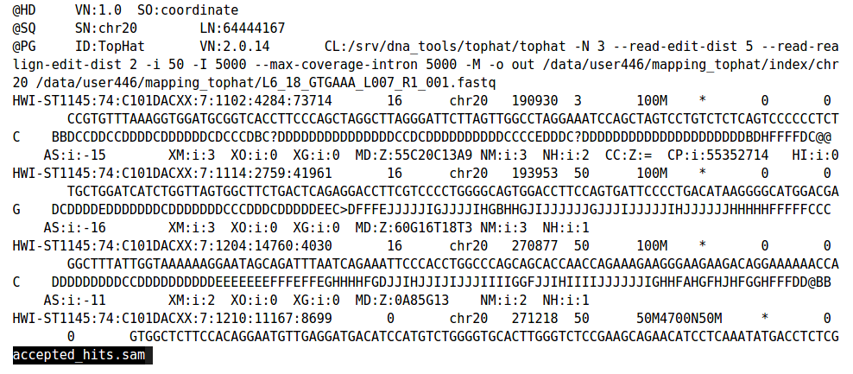
Aligned reads
View by Samtools
View by IGV

Slide 48
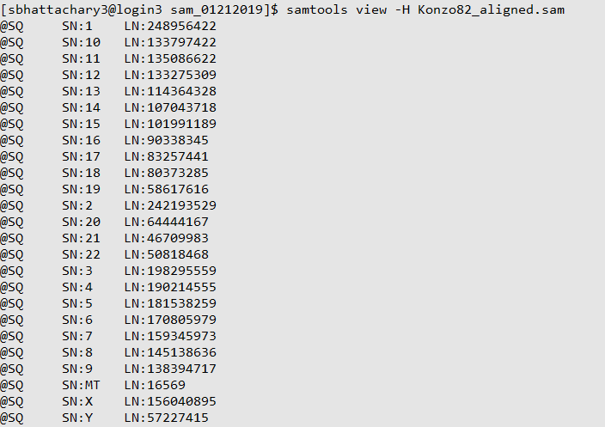
Samtool Headers
samtools view -H Konzo82_aligned.sam

Slide 49
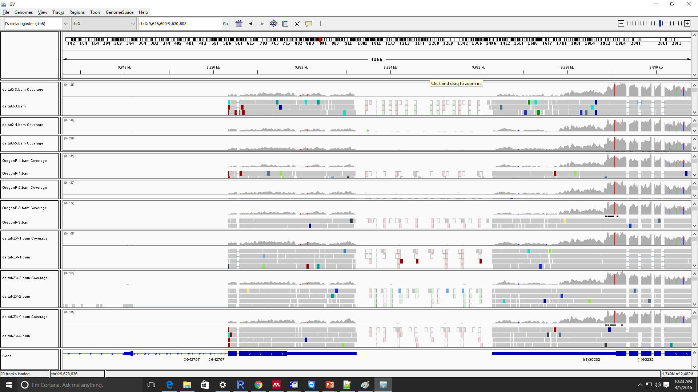
Integrated Genome Viewer (IGV)

Slide 50
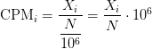
Read Counts
Raw reads: Number of reads that align to a reference sequence in the genome. It depends on amount of fragments sequenced and length of the reference sequence.
Counts Per Million (CPM): It is the raw counts (X_{i}) scaled by number of fragments sequenced (N) times one million.

Slide 51
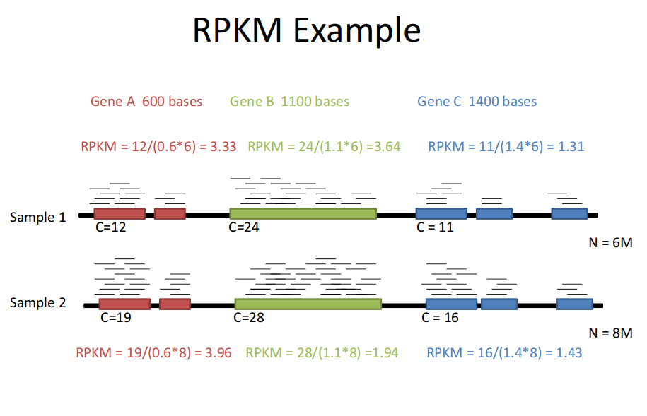
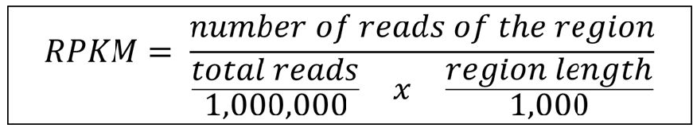
Read Counts (contd…)
Reads per kilobase of exons per million (RPKM) is a normalized read count.
Fragments per kilobase of exons per million (FPKM) is similar to RPKM, only it works for paired end reads.
https://izabelcavassim.wordpress.com/2015/03/09/rpkm-and-fpkm-normalization-units-of-expression/

Slide 52
Differential Gene Expression
Tool: DESeq2, edgeR
Input: Reads count (.CSV)
Output: TSV files and
Read Counts (CSV)
Isoform counts
DESeq2/edgeR
DIFFERENTIAL GENE EXPRESSION
Statistic results (.tsv)

Slide 53
Differential Expression
Mapped reads - condition 1
Genome
Mapped reads - condition 2

Slide 54
Differential Expression (contd..)
Counting reads
Statistical significance testing
Sample_A
Sample_B
Fold_Change
Significant?
Gene A
1
2
2-fold
No
Gene B
100
200
2-fold
Yes

Slide 55
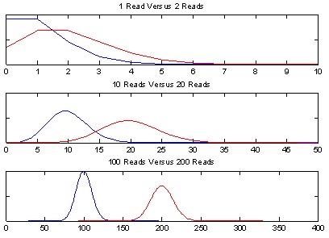
Beware of concluding fold change from small numbers of counts
Poisson distributions for counts based on 2-fold expression differences
No confidence in 2-fold difference. Likely observed by chance.
High confidence in 2-fold difference. Unlikely observed by chance.
From: http://gkno2.tumblr.com/post/24629975632/thinking-about-rna-seq-experimental-design-for
Notes:
Can’t deduce with confidence that the transcripts are two-fold differentially expressed based on the distribution of observed counts. Sequence deeper.
Poisson noise limits the ability to confidently detect differential expression with small values of read counts.

Slide 56
More Counts = more Statistical significance
Example: 5000 total reads per sample.
Observed 2-fold differences in read counts.
SampleA
Sample B
Hypothesis Test
(P-value)
geneA
1
2
1.00
geneB
10
20
0.098
geneC
100
200
< 0.001

Slide 57
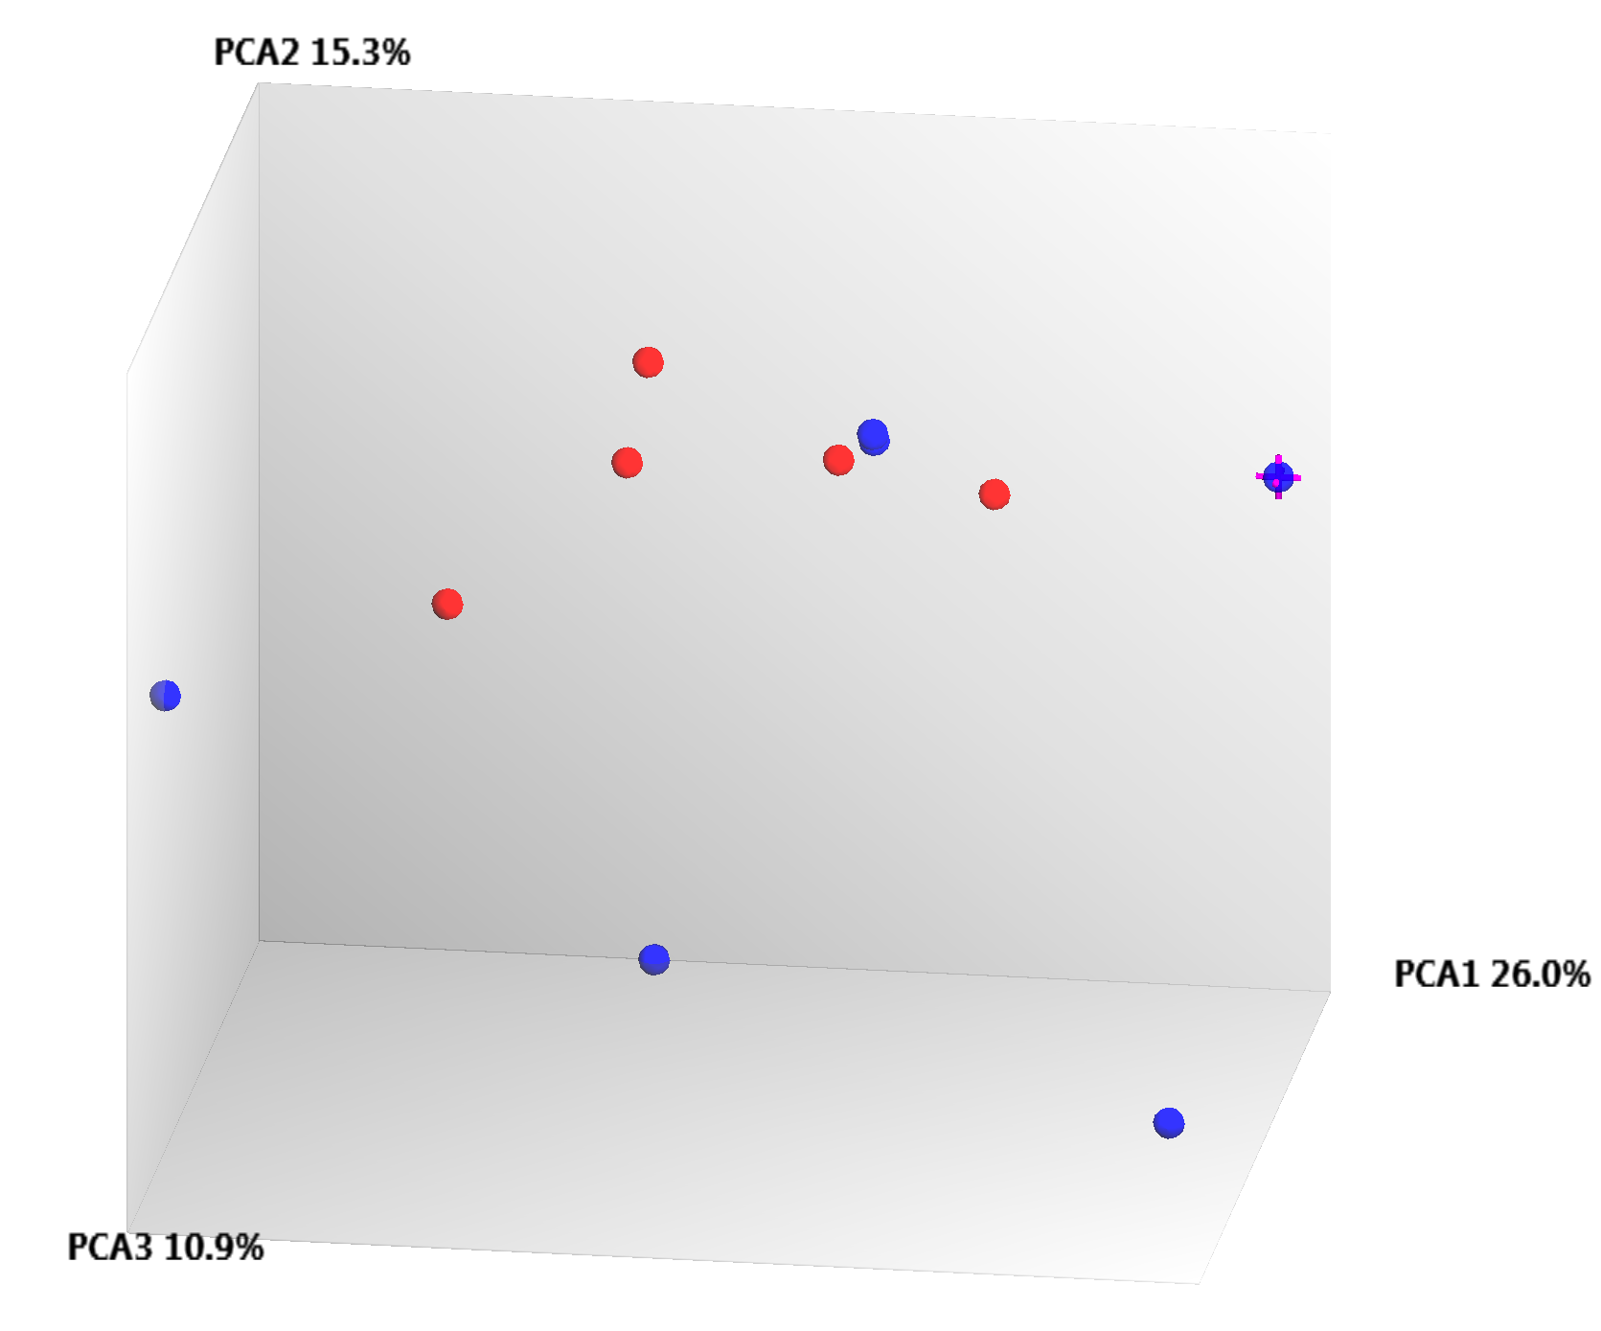
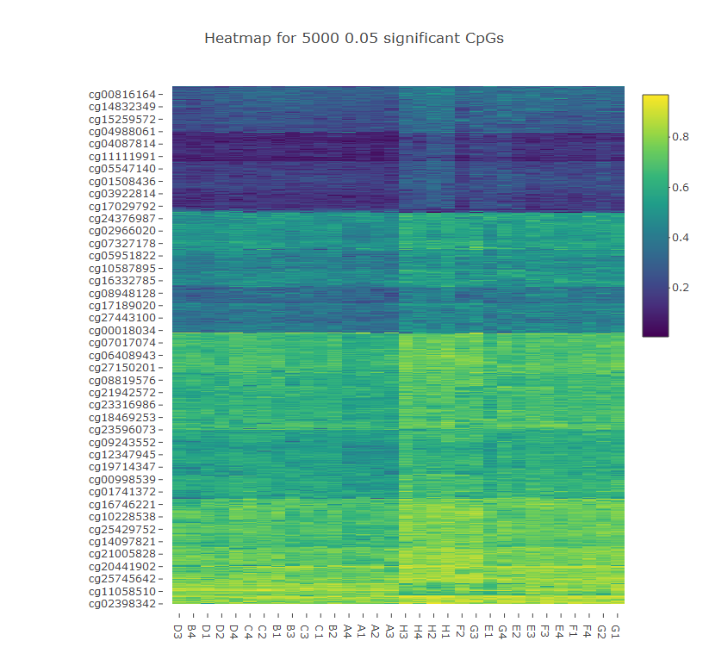
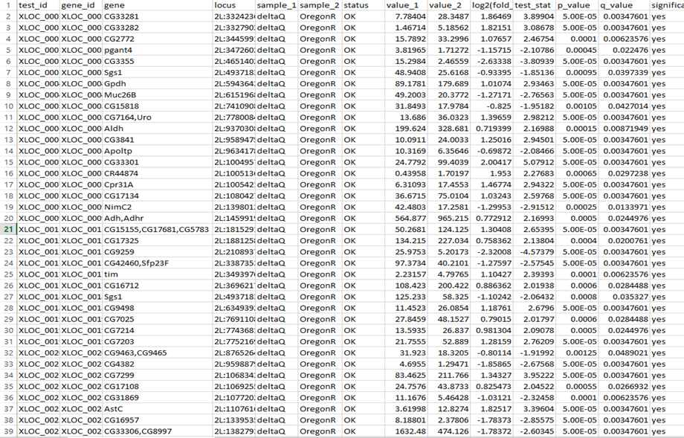
Outputs from Microarray and RNAseq
PCA Plot
Heatmap
Differential Expression Table

Slide 58
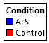
Principle component Analysis (PCA) Plot
Reduces the number of number of components for a condition.
Helps in visualizing variabilities within samples of the same condition.
In the figure on the right, there are 6 experimental (Blue) and 5 control conditions (Red).
We can see, 5 control samples are quite variable, whereas 2 out of 6 experimental samples have least variability.
Also there is variability between the experimental and the control samples.

Slide 59
Heatmaps
Heatmaps are visual representation of the expression of genes.
In the image on the right, color ranges from dark blue (low expression) to light yellow.
Expression can be represented either raw (raw intensity in case of microarray; raw read counts in case of RNA-seq) or scaled.
Scaling of expression data can be divided into 2 parts:
Logarithmic scaled
Z-score values

Slide 60
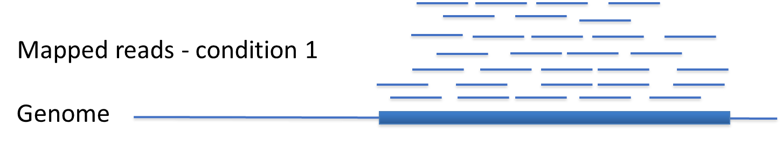
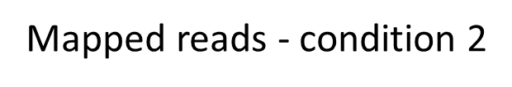
Differential Expression tables
Gene X
Gene X
Expression of Gene in condition 1 and condition2
Gene | Condition I | Condition II | Log fold change | T-test | P-value | Q-value
Gene X | 100 | 10 | 2.3 | 282.59 | 2.2e-16 | 2.2e-14

Slide 61
Differential Expression tables
Understanding output I (Hypothesis testing and pvalue)
Gene X
Gene X
Change in expression in log based 2 format
Gene | Condition I | Condition II | Log fold change | T-test | P-value | Q-value
Gene X | 100 | 10 | 2.3 | 282.59 | 2.2e-16 | 2.2e-14

Slide 62
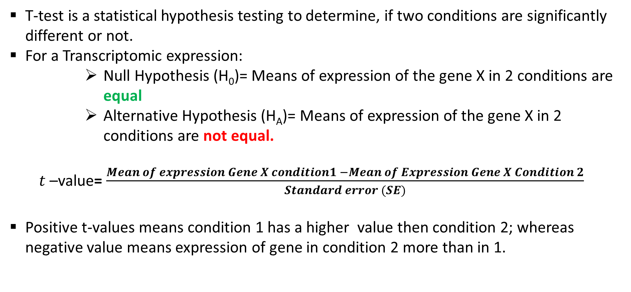
T-test
T-test is a statistical hypothesis testing to determine, if two conditions are significantly different or not.
For a Transcriptomic expression:
Null Hypothesis (H₀)= Means of expression of the gene X in 2 conditions are equal
Alternative Hypothesis (H_{A})= Means of expression of the gene X in 2 conditions are not equal.
$t$ –value= $\frac{Mean of expression Gene X condition1 −Mean of Expression Gene X Condition 2}{Standard error (SE)}$
Positive t-values means condition 1 has a higher value then condition 2; whereas negative value means expression of gene in condition 2 more than in 1.

Slide 63
P-values
P-value is the probability of occurrence of a given event.
In case of a t-test, higher p-value would signify the higher chance of Null Hypothesis being true. So a p-value of 0.99 means there is 99% chance that the 2 genes have same mean expression.
Lower the p-value, lesser the chance of the null hypothesis being true, and higher chance of alternative hypothesis being true. A p-value of 0.05, would mean 5% chance of the 2 genes having, same mean expression across the two conditions.
For biological experiments threshold for p-value is 0.05.
P-value depends on t-value and degrees of freedom, which is generally number of samples -1.

Slide 64
Differential Expression tables
Gene X
Gene X
Adjusted p-value for multiple test error correction
Gene | Condition I | Condition II | Log fold change | T-test | P-value | Q-value
Gene X | 100 | 10 | 2.3 | 282.59 | 2.2e-16 | 2.2e-14

Slide 65
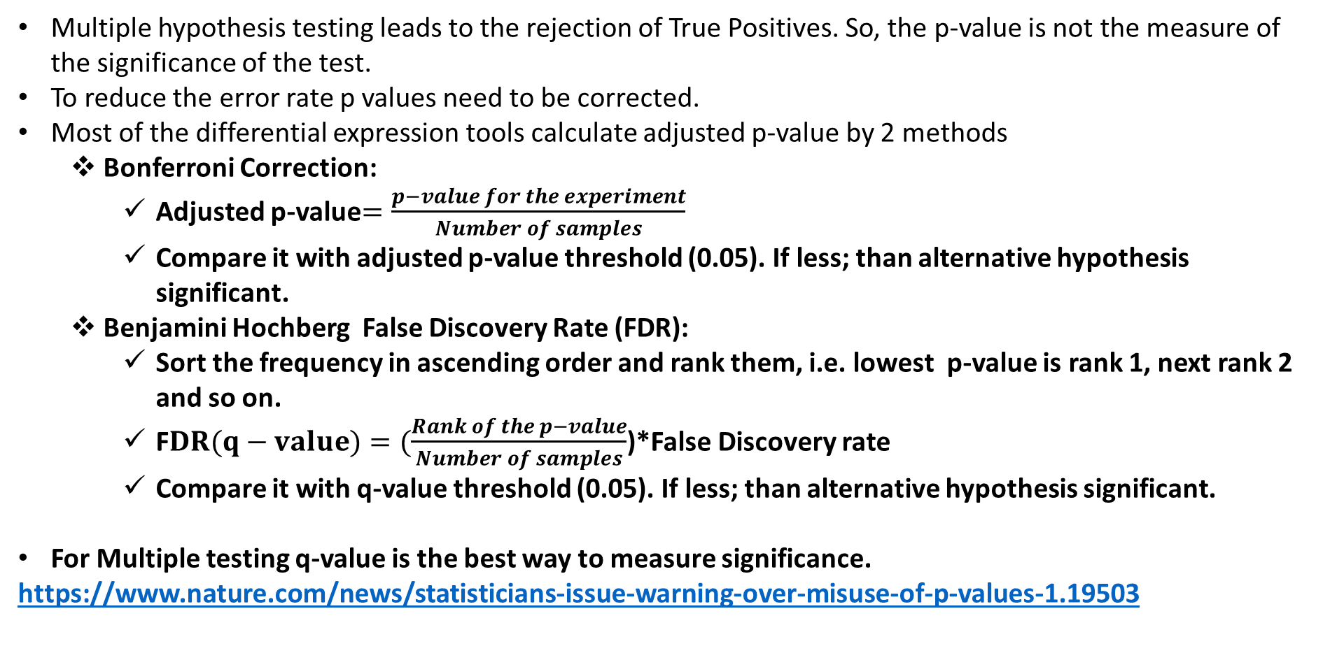
Adjusted P-values
Multiple hypothesis testing leads to the rejection of True Positives. So, the p-value is not the measure of the significance of the test.
To reduce the error rate p values need to be corrected.
Most of the differential expression tools calculate adjusted p-value by 2 methods
Bonferroni Correction:
Adjusted p-value$=\frac{p−value for the experiment}{Number of samples}$
Compare it with adjusted p-value threshold (0.05). If less; than alternative hypothesis significant.
Benjamini Hochberg False Discovery Rate (FDR):
Sort the frequency in ascending order and rank them, i.e. lowest p-value is rank 1, next rank 2 and so on.
F$DR(q−value)=(\frac{Rank of the p−value}{Number of samples}$)*False Discovery rate
Compare it with q-value threshold (0.05). If less; than alternative hypothesis significant.
For Multiple testing q-value is the best way to measure significance.
https://www.nature.com/news/statisticians-issue-warning-over-misuse-of-p-values-1.19503

Slide 66




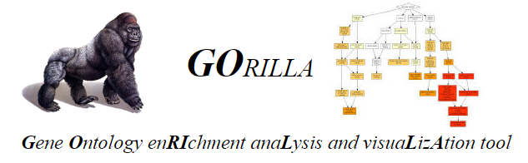
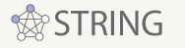
What to do with significant genes?
Significant Gene List
Functional Annotation
Interaction Database

